Slide 1


Tropospheric Ozone Assessment Report Phase II (TOAR II)
East Asia Focus Working Group
(EAWG)
Xiao Lu
Harvard U.
Ke Li
Harvard U.
Tatsuya Nagashima
NIES of Japan
Ja-Ho Koo
Yonsei U.
March 10, 2021

Slide 2
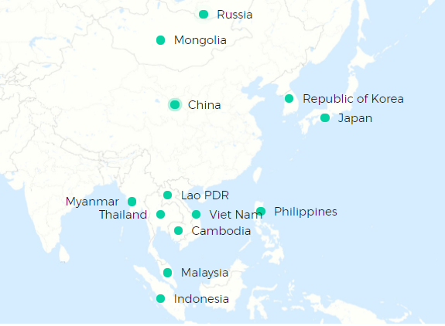
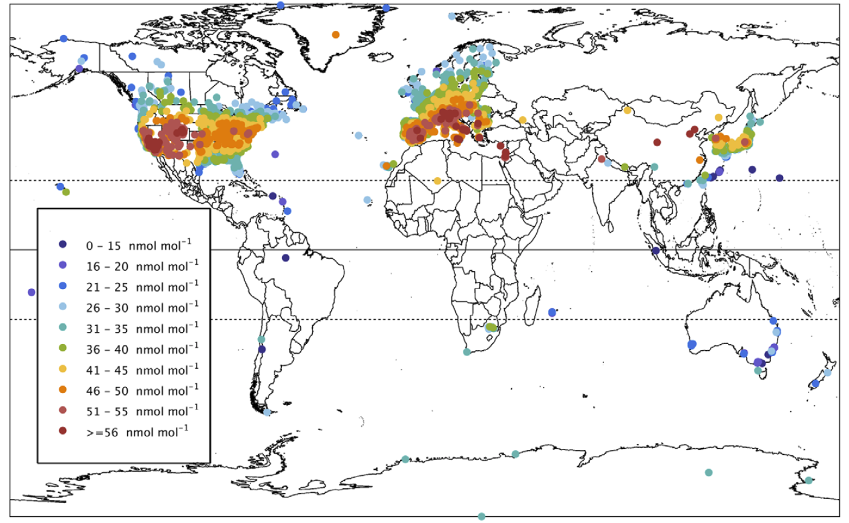
TOAR-II EAWG Motivation: ozone over EA was not well characterized in TOAR I
The East Asia region
JJA daytime average ozone, 2010-2014, TOAR I
https://www.eanet.asia/
[Gaudel et al., 2018, Elementa]

Slide 3


TOAR-II EAWG Challenges and priorities in ozone study over East Asia
Data collections
Surface/free tropospheric ozone observations are still sparse, some data are out there but not publically accessible.
Auxiliary/supporting data (precursor measurements, meteorological parameters/emission inventory, etc.) are poorly collected or shared.
Ozone trend attributions and global impacts
Ozone trends in East Asia are not well understood, models fail to capture the trends and disagree with each other on the trend attributions.
Global impacts of ozone change in East Asia need to be re-evaluated.

Slide 4
TOAR-II EAWG Goals
Goal 1: Construction of the EAO3 database
Ozone measurements from surface to free troposphere.
Auxiliary data, including in-situ meteorological data, ozone precursor and aerosol measurements, gridded anthropogenic and natural emissions, geographic data, etc.
Goal 2: Quantification of factors driving EA ozone trends
Quantify climatic and chemical factors driving EA ozone trends over East Asia, reconciling the results from different methods (statistics/CTMs/ML) using the same (similar) data source in EAO3 database.
Goal 3: Quantification of global influences of EA ozone and precursors
Quantify the influences of East Asia ozone and precursor outflow on intercontinental ozone transport, the global ozone budget, and radiative forcing.

Slide 5


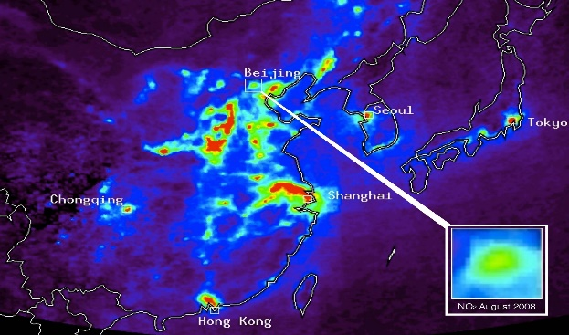
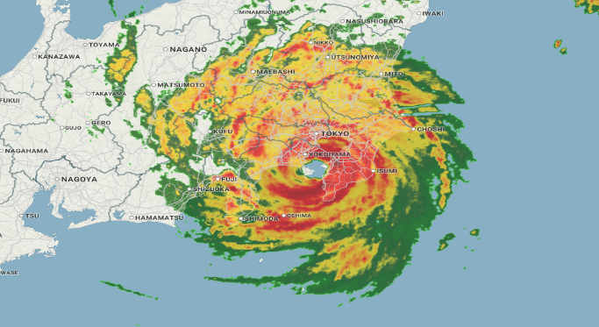

TOAR-II EAWG Goal 1: Construction of the EAO3 database
Help to maximize data sources
Ozone dataset
Ozone from the surface to tropopause (ozonesonde/lidar, aircraft, satellite), providing full pictures of ozone over EA.
Guide data portal, credit attributions, copyright handling, web service?
EAO3 database
TOAR II database
Precursors dataset
NO_{x}, CO, VOCs, PANs, PM_{2.5} from site observations, field campaigns, and satellite observations, supporting study on ozone chemistry, model validation, etc.
Ozone dataset
Precursors dataset
Emission and
Socioeconomic dataset
Meteorology dataset
In situ observations of meteorological parameters, supporting O₃-meteorology relationship studies and modeling activities.
Meteorology dataset
Emission dataset
Include anthropogenic and natural emissions for supporting modeling (CTM/statistical/ML) activities.
(Candidate data are listed in Table A1 in the proposal)

Slide 6
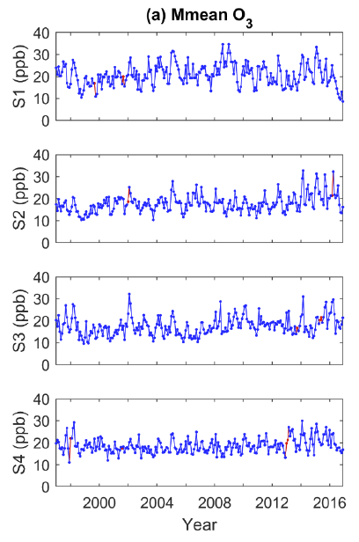
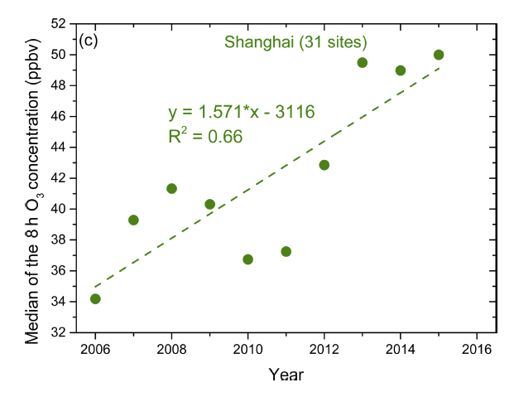
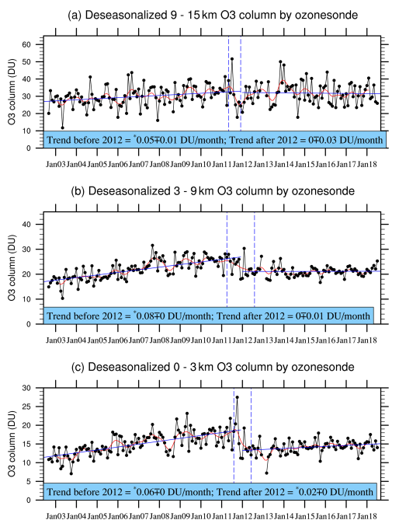
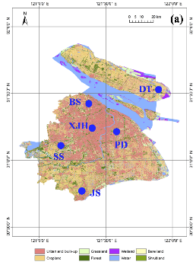
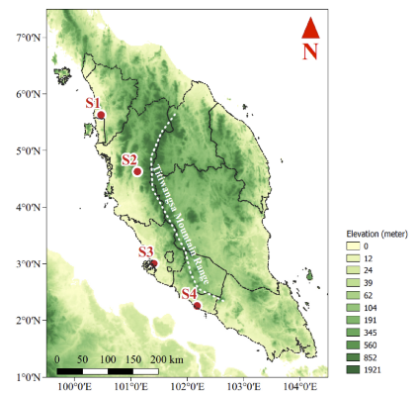
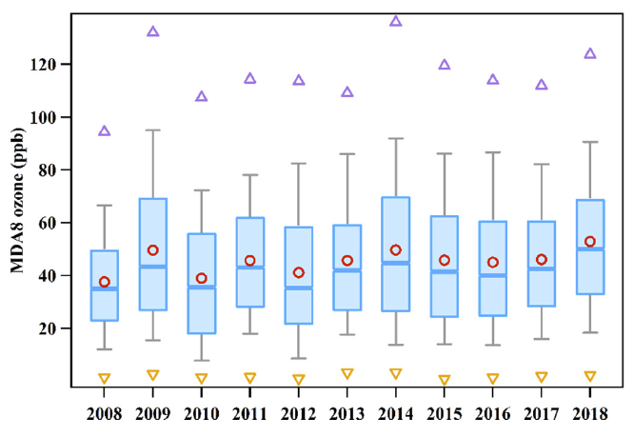
TOAR-II EAWG Goal 1: Construction of the EAO3 database
Examples of EA ozone measurements not included in the nationwide monitoring network (Table A1)
20-year surface ozone in
Malaysia
15-year surface ozone in
Shanghai/Guangzhou
15-year tropospheric ozone in
Beijing
[Ahamad et al. 2020]
[Xu et al. 2019; Yin et al., 2019]
[Zhang et al., 2020]

Slide 7
Highlight: ozonesonde measurement plan in South Korea
TOAR-II EAWG Goal 1: Construction of the EAO3 database
Plan 2021 at Anmyeondo
JUL-AUG: ~30 launches for the pre-ACCLIP and GEMS validation
(ACCLIP: Asian Summer Monsoon Chemical and Climate Impact Project by NCAR and NASA)
SEP-OCT: ~20 launches for the domestic monitoring with NIER
(NIER: National Institute of Environmental Research, Korea)
OCT: preliminary results will be presented in the Quadrennial Ozone Symposium (QOS). 3-9 October (qos2021.yonsei.ac.kr)
Seoul
Anmyeondo
(WMO-GAW station)
Pohang
(KMA station)
Plan 2022 at Anmyeondo
MAY-JUN: ~20 launches for the domestic monitoring with NIER
(comparison to the findings during the Korea-US Air Quality campaign, KORUS-AQ, in 2016)
JUL-AUG: ~30 launches for the main ACCLIP and GEMS validation
Jeju island
Anmyeondo Station
Plan at Pohang
Launching about every week since 1995.

Slide 8
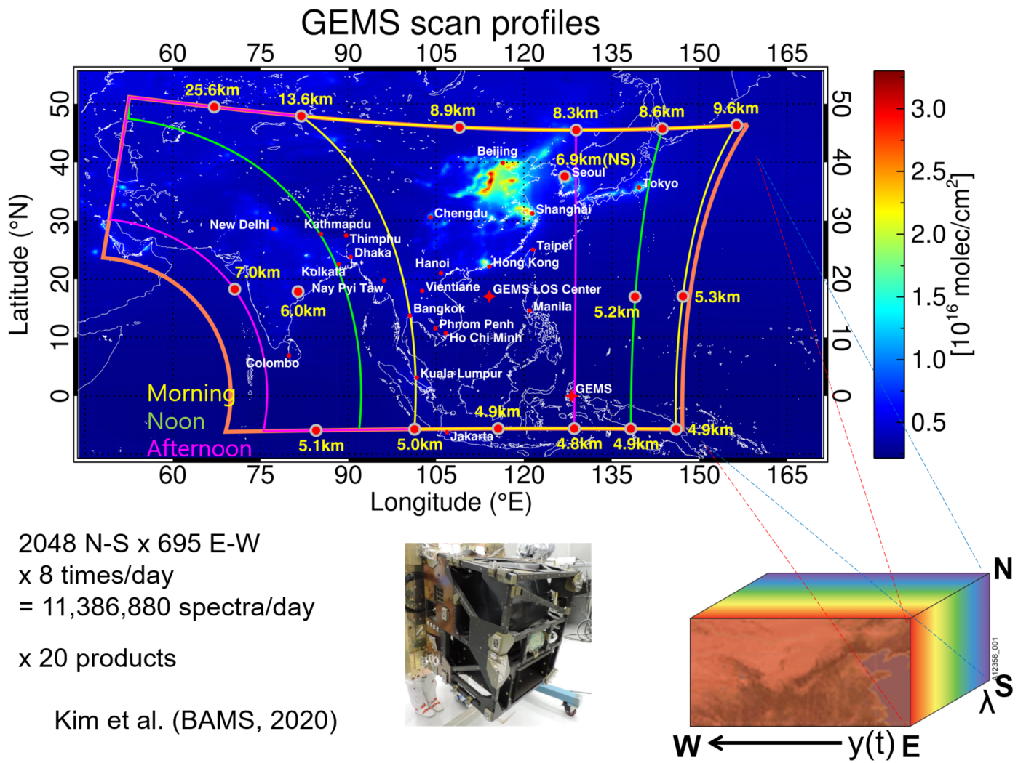


Highlight: Geostationary Environment Monitoring Spectrometer (GEMS)
TOAR-II EAWG Goal 1: Construction of the EAO3 database
Inter-comparison
(Courtesy of Jae-Hwan Kim, Pusan national Univ.)
Total column ozone (TCO)
X: Brewer obs. Y: pre-GEMS
(2004-2008)
Ozone profile
X: ozonesonde obs. Y: pre-GEMS
(2005-2006)
Time table:
Spring 2021: Total column ozone data will be released.
Spring 2022: Tropospheric ozone and ozone profiles will be released.

Slide 9
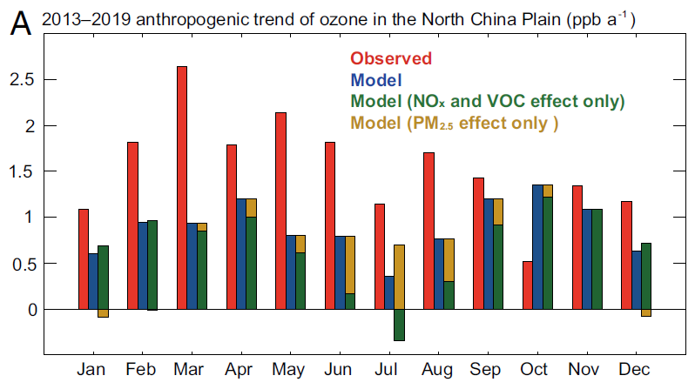




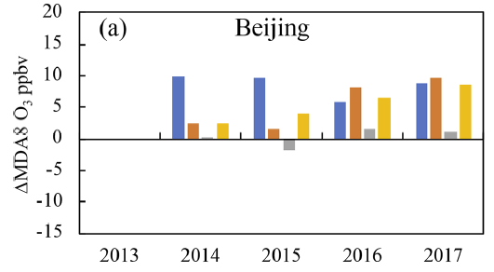

TOAR-II EAWG Goal 2: Quantification of factors driving EA ozone trends
Key questions to be answered:
What causes the model biases/discrepancies in capturing short-term/long-term ozone trends over EA?
What are the relative contributions of chemical vs. climatic factors to ozone trends? Can we reconcile the results from different methods?
EAO3 database
Different modeling tools
O₃ trend attributions
Statistical models
Ozone
Precursors
Machine learning
methods
[Li et al. 2021]
Meteorology
Emissions
Chemical model simulations
[Liu et al., 2020]

Slide 10
TOAR-II EAWG Goal 3: Quantification of global influences of EA O₃ and precursors
Key questions to be answered:
What are the short-term and long-term contributions of EA emissions to air quality downwind, global ozone budgets, and radiative forcing?
EAO3 database
EA ozone influences on:
Downwind air quality
Ozone
Precursors
Chemical (global) model simulations
Global ozone budgets
Meteorology
Emissions
Ozone radiative forcing

Slide 11
TOAR-II EAWG Team: 14 members from 7 countries/regions
Surface measurement; Ozonesonde; Satellite; Model
China: Meng Gao (Hong Kong Baptist University)
Jianlin Hu (Nanjing University of Information Science and Technology)
Keding Lu (Peking University)
Xiaobin Xu (China)
Likun Xue (Shandong University)
Japan: Junichi Kurokawa (Asian Center for Air Pollution Research)
Keiichi Sato (Asian Center for Air Pollution Research)
Seiji Sugata (National Institute for Environmental Studies)
South Korea: Juseon Bak (Pusan National University)
Dongwon Lee (National Institute of Environmental Research)
Mee-Hye Lee (Korea University)
Joowan Kim (Kongju National University)
USA: Yuqiang Zhang (Duke University)
Malaysia: Mohd Talib Latif (Universiti Kebangsaan Malaysia)
Thailand: Kasemsan Manomaiphiboon (King Mongkut’s University of Technology Thonburi)
Vietnam: Nguyen Tran Huong Giang (Da Lat University)

Slide 12

TOAR-II EA WG Expected outcome
The EAO3 database for supporting ozone research over East Asia.
A research article introducing the EAO3 database and overviewing the ozone and precursor levels/variations over East Asia.
A research article quantifying factors driving ozone trends over East Asia from different approaches.
A research article quantifying global influences of East Asian ozone and precursors.

Slide 13
TOAR-II EAWG Connections to the TOAR II and other WGs
Statistics
Working Group
Share observations/model results and interpretations
Guide trend calculations
ACM
Working Group
Update EA ozone trends;
Estimate global influences
East Asia Focus
Working Group
Guide data analyses and interpretation
South Asia
Working Group
Help to maximize data sources
OPT
Working Group
Guide data portal and web service?
TOAR II database
EAO3 database
etc.
Benefit future ozone study over East Asia!

Slide 14
TOAR-II EAWG Roadmap
Complete CTM simulations for ozone trend attribution.
Compare the results from different approaches for ozone trend drivers.
Conduct CTM simulations to quantify the impacts of EA ozone.
Collect and compile the EAO3 dataset.
Discuss the Statistical/ML/CTMs setup.
Spring-Summer
2021
Spring-Summer
2022
Spring-Fall
2023
Fall-Winter
2021
Fall-Winter
2022
EAWG Kick-off meetings.
Outline EAO3 dataset categories.
Reach out and invite research groups who would be interested in providing ozone and auxiliary data or joining modeling activities.
Complete and release the EAO3 dataset.
Conduct and complete statistical analyses for ozone trend attributions.
Conduct CTM simulations for ozone trend attribution.
Wrap up results and prepare for publication.
Summit for publication by 1 September, 2023

Slide 15
Back-up slides

Slide 16
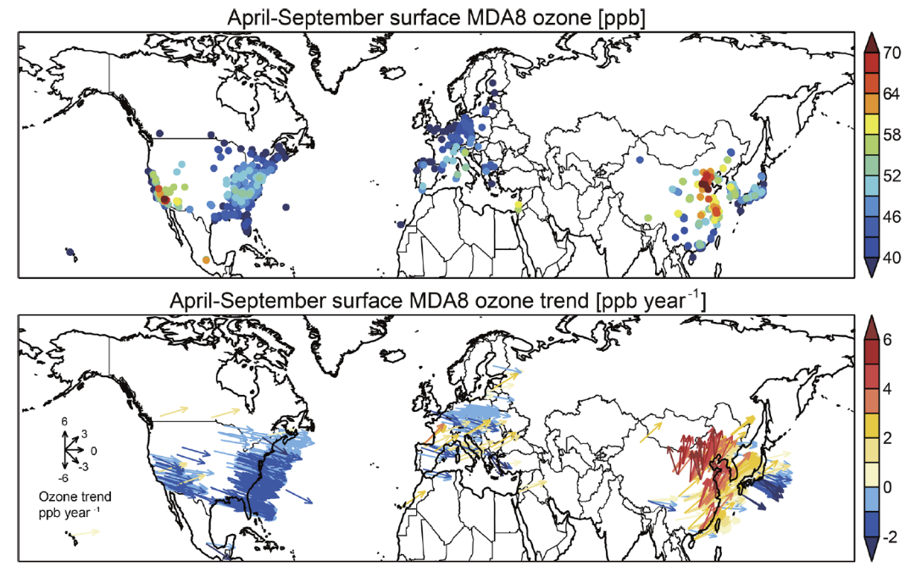
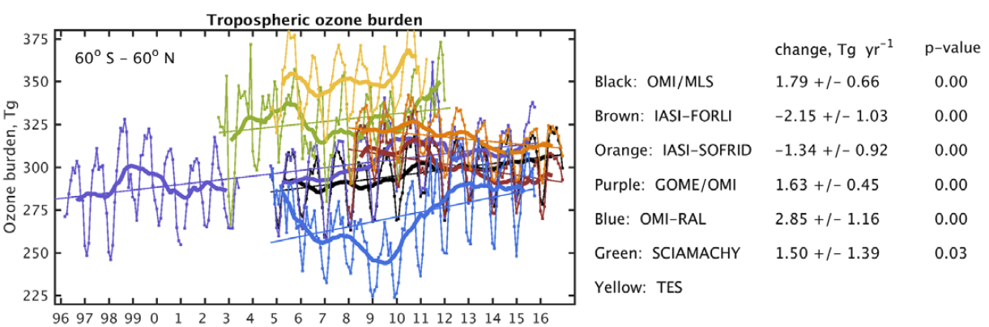
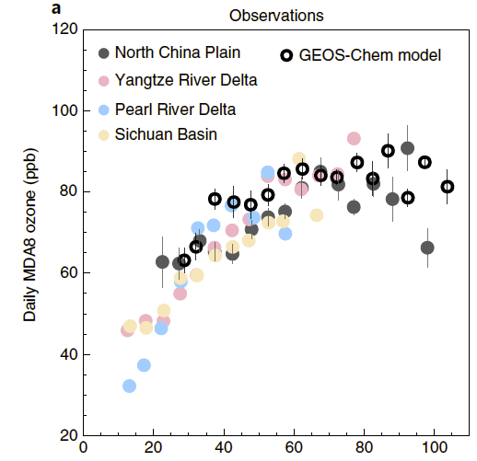
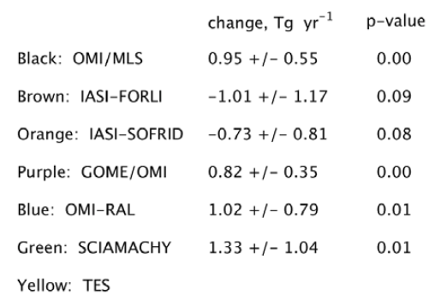
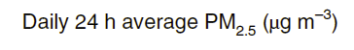
TOAR-II EAWG Motivation: EA is the current hotspot of ozone research
High and rising EA ozone levels
“Unique” and complex
precursor-O₃-PM_{2.5} chemistry
Global influences
China: 2013-2019; Others (TOAR I) : 2010-2014
China has the highest ozone levels and fastest short-term increasing rates
Suppression of O₃ in high PM_{2.5} conditions over China
Global O₃ burden increases
EA O₃ increases
[Lu et al. 2018, ESTL]
[Li et al. 2019, Nature Geoscience]
[Gaudel et al. 2018, Elementa]

